Slide 1

A+ Guide to Managing and Maintaining your PC, 6e
Chapter 10
Multimedia Devices and Mass Storage

Slide 2
Objectives
Learn about multimedia devices such as sound cards, digital cameras, and MP3 players
Learn about optical storage technologies such as CD and DVD
Learn how certain hardware devices are used for backups and fault tolerance
Learn how to troubleshoot multimedia and mass storage devices
A+ Guide to Managing and Maintaining your PC, 6e

Slide 3
Introduction
Multimedia capabilities of PCs:
  Text, graphics, audio, video, animation
Some applications for multimedia:
  Videoconferencing for executives
  Tools for teaching the alphabet to four-year-olds
Mass storage devices hold multimedia data
Types of mass storage
  CDs, DVDs, removable drives, and tape drives
A+ Guide to Managing and Maintaining your PC, 6e

Slide 4
Multimedia on a PC
Goal: generate output that emulates reality
Differences between cyberspace and real space
  Sights and sounds in reality are continuous (analog)
  Computer data is binary (discrete and digital)
Challenge: bridge world of cyberspace with reality
Topics covered:
  CPU technologies used to process multimedia data
  Multimedia devices; e.g., sound cards, MP3 players
A+ Guide to Managing and Maintaining your PC, 6e

Slide 5
CPU Technologies for Multimedia
Three early CPU improvements:
  MMX (Multimedia Extensions)
  SSE (Streaming SIMD Extension),
  SSE2, SSE3, and Hyper-Threading (HT)
Instruction set: operations a CPU can perform
  MMX and SSE help with repetitive looping
  SSE improves 3D graphics
Pentium 4 can use MMX, SSE, SSE2, SSE3, HT
AMD uses 3DNow!, HyperTransport!, PowerNow!
A+ Guide to Managing and Maintaining your PC, 6e

Slide 6
Sound Cards and Onboard Sound
Operations performed on sound:
  Basic: recording, storing, and replaying
  Advanced: editing and mixing
Types of ports
  Output ports: used by speakers
  Input ports: used by microphone, CD player, others
Surround Sound: supports eight separate channels
Sound Blaster card: standard for PC sound cards
Use CD/DVD drive or TV tuner card to bypass CPU
A+ Guide to Managing and Maintaining your PC, 6e

Slide 7
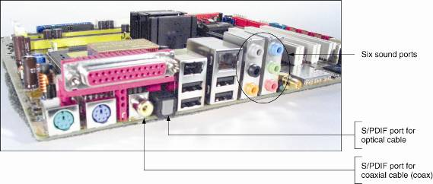
Figure 10-1 This motherboard with onboard sound has eight sound ports
A+ Guide to Managing and Maintaining your PC, 6e

Slide 8
Sound Cards and Onboard Sound (continued)
Three stages of computerizing sound:
  Sound is digitized (converted from analog to digital)
  Digital data is stored in a compressed data file
  Sound is synthesized (digital to analog or digital out)
Sampling: process of digitizing sound
Sample size: number of bits to store sample; e.g., 16
  Larger sample sizes improve accuracy of sampling
Sampling rate: samples (cycles) per second (Hz)
  Should be twice the frequency of an analog signal
A+ Guide to Managing and Maintaining your PC, 6e

Slide 9
Sound Cards and Onboard Sound (continued)
24-bit Creative Labs Sound Blaster card
  Has a universal PCI connector
  Works under Windows and DOS
  Four color-coded ports
  Two internal connections to component in case
Tips for installations under Windows 2000/XP
  Run the setup program before installing the card
  Drivers not digitally signed may still work in Windows
  You must have administrative privileges
  Use Device Manager to verify installation is error-free
A+ Guide to Managing and Maintaining your PC, 6e

Slide 10
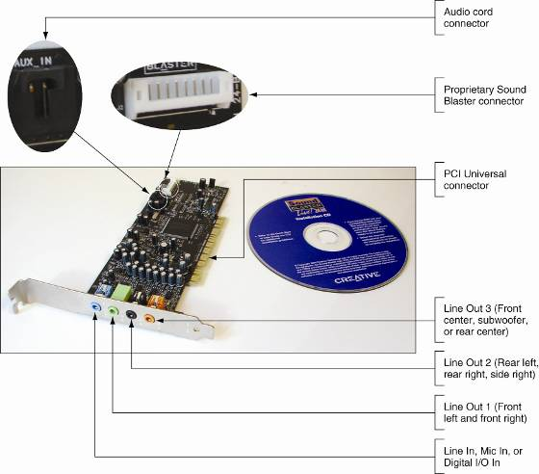
Figure 10-2 The Sound Blaster PCI 24-bit sound card has two internal connections and four ports
A+ Guide to Managing and Maintaining your PC, 6e

Slide 11
Digital Cameras and Flash Memory Devices
A digital camera works like a scanner
  Scans the field of image set by the picture taker
  Translates the light signals into digital values
  Digital values can be stored, viewed, edited, printed
TWAIN: format for transferring images to a PC
  Connections may be cabled or wireless
Solid state device (SSD): memory based on a chip
  Examples: thumb drives and flash memory cards
Flash memory cards are used in digital cameras
A+ Guide to Managing and Maintaining your PC, 6e

Slide 12
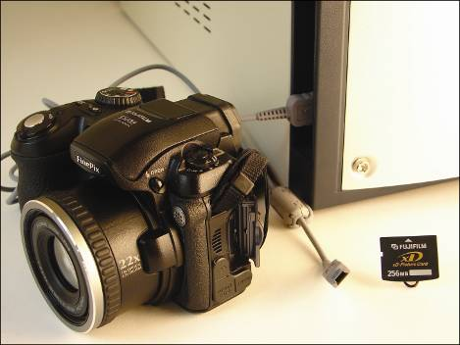
Figure 10-13 This digital camera uses an xD Picture Card and uploads images by way of a USB cable
A+ Guide to Managing and Maintaining your PC, 6e

Slide 13
Digital Cameras and Flash Memory Devices (continued)
Transferring images to your PC
  Install the software bundled with your camera
  Connect your camera to the PC
  Upload the images
Editing or printing images once they are on the PC
  Use image-editing software; e.g., Adobe Photoshop
Picture file formats:
  JPEG (Joint Photographic Experts Group) format
  TIFF (Tagged Image File Format)
Connect camera to TV using the video-out port
A+ Guide to Managing and Maintaining your PC, 6e

Slide 14
Web Cameras and Microphones
Web camera: captures digital video for use on Web
Two meanings of Web cam:
  Digital video camera
  Web site providing live or prerecorded video broadcast
Setting up a personal Web cam for a chat session
  Use setup CD to install software
  Plug in Web camera into a USB port
  If sound is needed, plug in speakers and microphones
  Use chat software to create a live video session
A+ Guide to Managing and Maintaining your PC, 6e

Slide 15
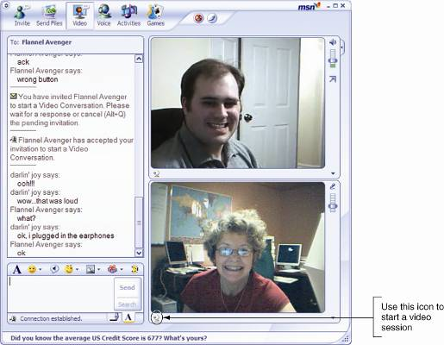
Figure 10-17 Instant Messenger session using a Web camera
A+ Guide to Managing and Maintaining your PC, 6e

Slide 16
MP3 Players
MP3 player: device that plays MP3 (.mp3) files
Moving Pictures Experts Group (MPEG)
  Standard for data compression (MPEG-1 to MPEG-4)
  Stores data that changes from one frame to the next
  Yields compression ratio of 100:1 for full-motion video
MP3 files are downloaded from PC to MP3 player
Streaming audio: playing MP3 files directly from Web
Music files on CDs can be converted to MP3 format
A+ Guide to Managing and Maintaining your PC, 6e

Slide 17
MIDI Devices
Musical instrument digital interface (MIDI)
Set of standards representing music in digital form
  Specify how to digitally describe and store every note
  Specify how to connect electronic music equipment
MIDI software offers a wide range of editing options
  Example: add your own voice to a song
MIDI port
  5-pin DIN resembling a keyboard port
  Either an input port or output port, but not both
A+ Guide to Managing and Maintaining your PC, 6e

Slide 18
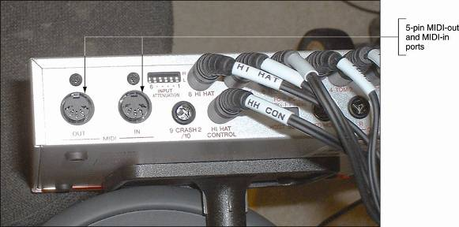
Figure 10-19 MIDI ports on an electronic drum set
A+ Guide to Managing and Maintaining your PC, 6e

Slide 19
TV Tuner and Video Capture Cards
TV tuner card: interfaces a PC with a TV
Video capture card: saves video input to hard drive
TV tuner/video capture card may also be a video card
Three ways to incorporate tuner and capture features
  Embed TV tuners and TV captures in motherboard
  Fit card to fit into a PCI, PCI Express x16, or AGP slot
  Connect external device to a USB port
NTSC (National Television Standards Committee)
  Sets standards for TV tuners and video capture cards
A+ Guide to Managing and Maintaining your PC, 6e

Slide 20
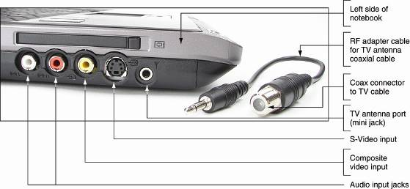
Figure 10-22 This notebook computer has embedded TV tuner and video capture abilities
A+ Guide to Managing and Maintaining your PC, 6e

Slide 21
Optical Storage Technology
CDs and DVDs are optical storage technologies
  Pattern of bits on surface of disc represent bits
  Laser beam reads the bits
CDFS (Compact Disc File System)
  Original file system (still used by CDs)
UDF (Universal Disk Format) file system
  New file system (used by DVDs and CDs)
Windows supports CDFS and UDF
A+ Guide to Managing and Maintaining your PC, 6e

Slide 22
Using CDs
CD drives are read-only or read/writable
CD surface
  Continuous spiral of sectors of equal length
  Data stored as lands (1) or pits (0)
Process of reading data
  Laser beam is passed over pits and lands on surface
  Drive reads bit value by amount of laser deflection
Process of writing data
  CD imprinted (burned) with lands and pits
  Acrylic surface is added to protect the data
A+ Guide to Managing and Maintaining your PC, 6e

Slide 23
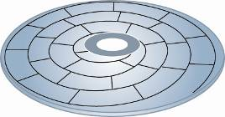
Figure 10-26 The spiral layout of sectors on a CD surface
A+ Guide to Managing and Maintaining your PC, 6e

Slide 24
Using CDs (continued)
CD must read data at a constant rate
Problem: linear velocity varies over rotating disk
Solution 1: maintain constant linear velocity (CLV)
  Slow down disk when laser is near center (200 rpm)
  Speed up disk as laser goes to outer edge (500 rpm)
  Rates given allow for transfer of 150 KBps (audio)
  Drive speed must be increased for video
Solution 2: maintain constant angular velocity (CAV)
  Disk rotates at a constant speed
  Technology is used in hard disks
A+ Guide to Managing and Maintaining your PC, 6e

Slide 25
Using CDs (continued)
Types of CD drives (also identifies disk)
  CD-ROM drive: read only memory
  CD-R drive: recordable CD
  CD-RW: rewritable CD
How an optical drive interfaces with motherboard
  Using an ATA or SCSI interface
  Using external drive that plugs into port, such as USB
Installing a CD drive
  Installed drive identified in directory by letter; e.g., D
  Four choices for installation using parallel ATA (EIDE)
A+ Guide to Managing and Maintaining your PC, 6e

Slide 26
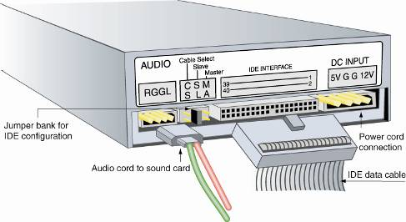
Figure 10-30 Rear view of an EIDE CD drive
A+ Guide to Managing and Maintaining your PC, 6e

Slide 27
Using DVDs
DVD (digital video disc or digital versatile disc)
  Single-sided holds up to 8.5 GB of data (movie length)
  Double-sided disc can hold 17 GB of data
  Uses the Universal Disk Format (UDF) file system
Distinguishing between a CD and DVD
  DVD can use top and bottom surfaces to hold data
  Second opaque layer nearly doubles disc capacity
Audio data stored in Surround Sound
Video data stored using MPEG-2 video compression
A+ Guide to Managing and Maintaining your PC, 6e

Slide 28
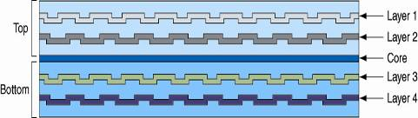
Figure 10-37 A DVD can hold data in double layers on both the top and bottom of the disc yielding a maximum capacity of 17 GB
A+ Guide to Managing and Maintaining your PC, 6e

Slide 29
Using DVDs (continued)
Various standards used for reading and writing
Selection criteria for a DVD drive
  The standards supported by the drive
  Ability of drive to burn CDs
  Write-once and rewritable speeds
Latest DVD formats: HD-DVD and Blu-ray
Installing a DVD drive
  Follow the same procedure used for CD drives
  Cabling: power cord, EDEI data cable, audio cord
  4-pin connector for analog sound, 2-pin for digital sound
A+ Guide to Managing and Maintaining your PC, 6e

Slide 30
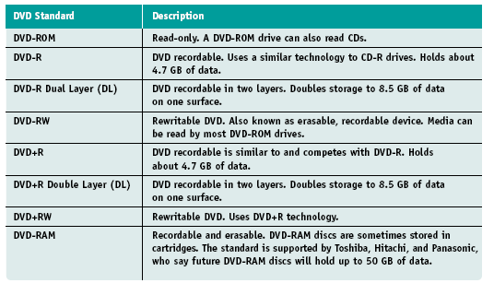
Table 10-7 DVD standards
A+ Guide to Managing and Maintaining your PC, 6e

Slide 31
Caring for Optical Drives and Discs
Causes of problems:
  Dust, fingerprints, scratches, defects, electrical noise
  Drive is standing vertically
Some precautions to follow:
  Hold the disc by the edge
  Use a soft, dry cloth to remove dust and fingerprints
  Don’t paste paper on the surface of a CD
  Don’t subject a disc to heat or leave it in direct sunlight
  Don’t make the center hole larger
  Don’t bend a disc
A+ Guide to Managing and Maintaining your PC, 6e

Slide 32
Hardware used for Backups and Fault Tolerance
Frequent backups help preserve valuable data
  Backup data after four to ten hours of data entry
Backup media: disc, file server, tape drives
Providing backup for an organization
  Consider the nature of data and organization’s policy
  One solution: backup data to another PC on network
Providing backup for a small office
  One options: backup data to a second hard drive
  Utilize an online backup service
A+ Guide to Managing and Maintaining your PC, 6e

Slide 33
Tape Drives
Offer inexpensive, high capacity storage
Advice: use backup software to manage backups
Main disadvantage: data accessed sequentially
  Makes file retrieval slow and inconvenient
A tape drive can be internal or external
How a tape drive interfaces with a computer
  External or internal drive can use a SCSI bus
  External or internal drive can use a USB connection
  Internal drive can use parallel or serial ATA interface
A+ Guide to Managing and Maintaining your PC, 6e

Slide 34
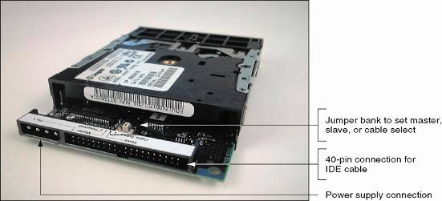
Figure 10-41 The rear of a parallel ATA (IDE ATAPI) tape drive
A+ Guide to Managing and Maintaining your PC, 6e

Slide 35
Tape Drives (continued)
The tapes used by a tape drive
  Full-sized data cartridges 4 x 6 x 5/8 inches
  Smaller minicartridges 3 1/4 x 2 1/2 x 3/5 inches
Writing to tapes is similar to writing to floppy drives
  FAT at start of the tape tracks data and bad sectors
  The tape must be formatted before use
When purchasing tapes, match tape to tape drives
Some tips for cleaning and care
  Keep tapes away from magnetic fields, heat, cold
  Clean drive heads as recommended by manufacturer
A+ Guide to Managing and Maintaining your PC, 6e

Slide 36
Removable Drives
Advantages
  Increases the overall storage capacity of a system
  Simplifies transfer of large files from one PC to another
  Makes it easy to backup and secure important files
Drop height: height device can fall and still be usable
Half-life: time for magnetic strength to weaken by half
  Example: writable CDs have half-life of 30 years
Examples: Microdrive CF, jump drive, Zip drive
Internal removable drive installed like a hard drive
A+ Guide to Managing and Maintaining your PC, 6e

Slide 37
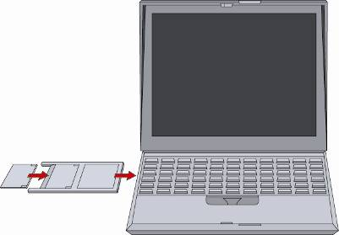
Figure 10-47 The Microdrive CF inserts into a PC Card adapter, which fits into a notebook PC Card slot
A+ Guide to Managing and Maintaining your PC, 6e

Slide 38
Fault Tolerance, Dynamic Volumes, and RAID
Fault tolerance: ability to respond to serious problem
  Example: hardware failure or power outage
RAID (redundant array of independent) disks
  System used to recovers from failure
  Also improves performance
Two methods used to configure a hard drive:
  Basic disk: creates logical drives within fixed partitions
  Dynamic disk: creates dynamic volumes
Dynamic disks can only be read by Windows 2000/XP
A+ Guide to Managing and Maintaining your PC, 6e

Slide 39
Fault Tolerance, Dynamic Volumes, and RAID (continued)
Five types of dynamic volumes:
  Simple: primary partition on a basic disk
  Spanned: can use space from two or more disks
  Striped (RAID 0): data striping across two or more disks
  Mirrored (RAID 1): duplicates data on another drive
  RAID 5: striping across drives and parity checking
Three ways to adapt a system to hardware RAID
  Motherboard IDE controller supports RAID
  Install a RAID-compliant IDE controller
  Install a SCSI host adapter that supports RAID
A+ Guide to Managing and Maintaining your PC, 6e

Slide 40
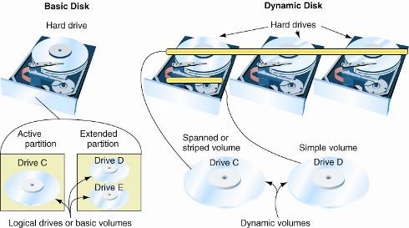
Figure 10-51 Basic disks use partitions and logical drives to organize a hard drive, and dynamic disks use dynamic volumes to organize multiple hard drives
A+ Guide to Managing and Maintaining your PC, 6e

Slide 41
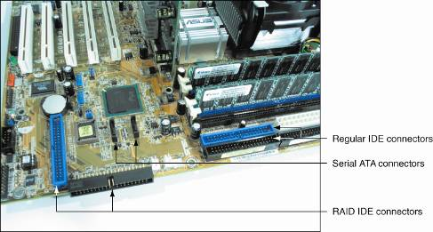
Figure 10-52 This motherboard supports RAID 0 and RAID 1
A+ Guide to Managing and Maintaining your PC, 6e

Slide 42
Troubleshooting Multimedia Devices
General guidelines
  Do not touch chips on circuit boards
  Do not touch disk surfaces where data is stored
  Don not stack components on top of one another
  Do not subject components to magnetic fields or ESD
A+ Guide to Managing and Maintaining your PC, 6e

Slide 43
Problems with CD, CD-RW, DVD, or DVD-RW Installation
Check data cable and power cord connections
For an EIDE drive, check master/slave jumper set
For an SCSI drive, check the ID settings
Check for devices using the same port settings
Run a virus scan program
A+ Guide to Managing and Maintaining your PC, 6e

Slide 44
Problems when Burning a CD
Make sure the disk capacity has not been exceeded
Ensure hard drive has at least 1 GB of free space
Close other programs before you begin
Try a different brand of CDs
Try using a slower burn rate
A+ Guide to Managing and Maintaining your PC, 6e

Slide 45
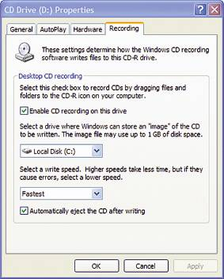
Figure 10-54 Slow down the CD-RW write speed to account for a slow Windows system
A+ Guide to Managing and Maintaining your PC, 6e

Slide 46
Troubleshooting Sound Problems
Some questions to ask:
  Are the speakers turned on?
  Is the speaker volume turned up?
  Is the volume control for Windows turned up?
Some troubleshooting tasks for installation problems
  Download new or updated drivers
  Uninstall and reinstall the sound card
Some ways to resolve issue of games without sounds
  Update and install new drivers
  Reduce sound acceleration
A+ Guide to Managing and Maintaining your PC, 6e

Slide 47
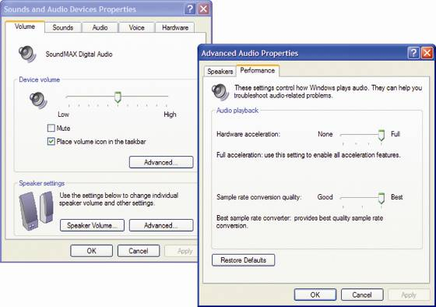
Figure 10-55 Adjust sound hardware acceleration
A+ Guide to Managing and Maintaining your PC, 6e

Slide 48
Troubleshooting Tape Drives
A minicartridge does not work
  Verify that the minicartridge is write-enabled
  Take the minicartridge out and reboot
Data transfer is slow
  Change software settings for speed and compression
The drive does not work after the installation
  Use Device Manager to check for errors
The drive fails intermittently or gives errors
  Try a new tape
  Reformat the tape
A+ Guide to Managing and Maintaining your PC, 6e

Slide 49
Summary
Multimedia devices use digital data to model reality
Sampling digitally captures analog sights and sounds
Sound cards enable you to record, store, replay, and edit sound
Digital cameras work much like scanners
Important image formats: JPEG and TIFF
A+ Guide to Managing and Maintaining your PC, 6e

Slide 50
Summary (continued)
MPEG: set of compression standards for motion pictures, video, and audio
Types of optical storage technology: CDs and DVDs
CD/DVD disk surface uses lands and pits to represent binary data
Other mass storage devices: tape drives, removable drives such as Zip
RAID: system for providing fault tolerance and improving performance
A+ Guide to Managing and Maintaining your PC, 6e

